Slide 1

Welcome
Agile, Scrum
Notes:
The Agile team is at the core of Agile software development, and its effectiveness heavily relies on collaboration, communication, and the ability to adapt to changing circumstances. Agile teams often work in close collaboration with stakeholders, including product owners, customers, and end-users, to deliver valuable software that meets user needs and expectations.

Slide 2
What is Agile?
Framework
Project Management Technique
Using JIRA for tickets
Methodology
“Feel good” industry hot trend
Software Development Process
Do “something” faster
Doing Daily Stand-up
Forming small teams
Notes:
Agile has gained widespread adoption in the software development industry due to its focus on delivering customer value, fostering collaboration, and enabling teams to respond effectively to changing requirements and market dynamics.
Agile methodologies, such as Scrum, Kanban, Extreme Programming (XP), and others, provide specific frameworks and practices for implementing the Agile principles. These methodologies offer processes for iterative development, regular inspection, and continuous improvement.

Slide 3



What is Agile?
Is a Mindset
Described & Defined by
Agile Manifesto (4 values & 12 principles)
Manifested through many practices
(Scrum, XP, Kanban, SAFe)
Agile is change in culture & values of an organization & its people
Notes:
Agile methodologies, such as Scrum, Kanban, Extreme Programming (XP), and others, provide specific frameworks and practices for implementing the Agile principles. These methodologies offer processes for iterative development, regular inspection, and continuous improvement.

Slide 4
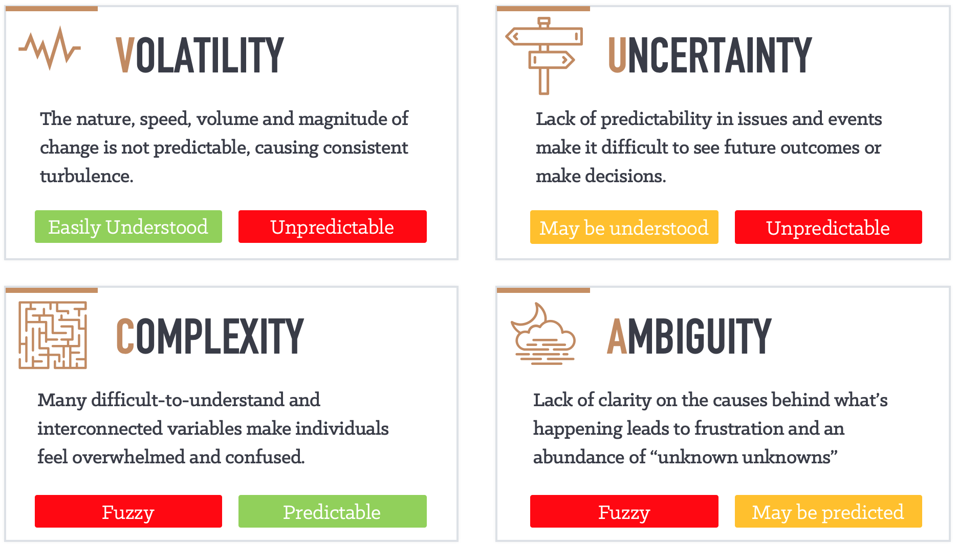
Another Dimension – VUCA world

Slide 5

Activity – Traditional vs Agile
Notes:
Activity: 10 minutes

Slide 6
Traditional vs Agile Approach
Traditional
Agile
Short, sharp cycles—able to change direction and react more quickly
Flexibility
Visibility
User engagement and frequent delivery—highly visible
Lower delivery risks through smaller but many deliveries to “release”
Delivery risk
Each cycle should deliver business benefit allowing early accrual
Business value

Slide 7
4 values - Agile Manifesto
We are uncovering better ways of developing software by doing it and helping others do it. Through this work we have come to value:
4 values of Agile Manifesto
Customer collaboration
Working software
Responding to change
Individuals and interactions
over
over
over
over
Contract negotiation
Comprehensive documentation
Following a plan
Processes and tools
Ambition: Create a culture of continuous improvement.
Notes:
The Agile Manifesto and its principles provide a foundation for Agile methodologies like Scrum, Kanban, and Extreme Programming (XP). These values and principles promote a customer-centric, flexible, and iterative approach to software development, resulting in the efficient delivery of valuable software that meets customer needs.

Slide 8
12 Principles of Agile
Early and Continuous Delivery of Valuable Software
Embrace Change
Deliver value often/Frequent Delivery
Business and Developers Together
Empower individuals
Rhythm for communication
Measure progress by working software
Use sustainable processes
Strive for excellence
Simplicity
Self-organizing teams
Regular Reflection and Adjustment
Principles behind the Agile Manifesto
Notes:
“Simplicity is the art of maximizing the work not done.” This idea is central to eliminating waste. To make your process more agile, do less. However, you can't take so much out of your process that it no longer works.

Slide 9
Agile principles
Early and Continuous Delivery of Valuable Software: Our highest priority is to satisfy the customer through early and continuous delivery of valuable software.
Embrace Change: Welcome changing requirements, even late in development. Agile processes harness change for the customer's competitive advantage.
Deliver value often/Frequent Delivery: Deliver working software frequently, from a couple of weeks to a couple of months, with a preference to the shorter timescale.
Business and Developers Together: Business people and developers must work together daily throughout the project.

Slide 10
Agile principles
Empower individuals: Build projects around motivated individuals. Give them the environment and support they need, and trust them to get the job done.
Rhythm for communication: The most efficient and effective method of conveying information to and within a development team is face-to-face conversation.
Measure progress by working software: Working software is the primary measure of progress.
Use sustainable processes: Agile processes promote sustainable development. The sponsors, developers, and users should be able to maintain a constant pace indefinitely.

Slide 11
Agile principles
Strive for excellence: Continuous attention to technical excellence and good design enhances agility.
Simplicity: Simplicity--the art of maximizing the amount of work not done--is essential.
Self-organizing teams: The best architectures, requirements, and designs emerge from self-organizing teams.
Regular Reflection and Adjustment: At regular intervals, the team reflects on how to become more effective, then tunes and adjusts its behaviour accordingly.

Slide 12
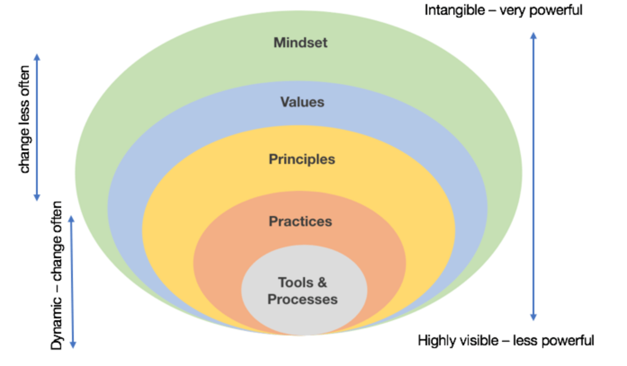
Being Agile vs Doing Agile
Organization Culture, People Behavior
Being Agile
Agile Manifesto
Scrum XP, Kanban
Doing Agile
Jira, Azure, DevOps
Notes:
"Being Agile" and "Doing Agile" are two different perspectives that reflect how an organization or team approaches Agile principles and practices. These concepts highlight the difference between embracing the Agile mindset as part of the organizational culture ("Being Agile") and simply following Agile practices without fully understanding the underlying principles ("Doing Agile").
Being Agile: "Being Agile" goes beyond adhering to Agile practices and methodologies. It involves adopting the Agile mindset and values, which include collaboration, adaptability, customer focus, and continuous improvement. When an organization or team is truly "being Agile," they internalize these values and incorporate them into their culture and decision-making processes. It's about understanding the why behind Agile practices and adapting them to fit the unique needs of the organization. Characteristics of "Being Agile" include:
Embracing a culture of collaboration and openness.
Prioritizing customer needs and delivering value.
Encouraging continuous learning and improvement.
Focusing on outcomes rather than just outputs.
Adapting to change and uncertainty.
Doing Agile: "Doing Agile" refers to the act of following Agile practices and methodologies without necessarily embodying the Agile values and mindset. In this scenario, teams might implement Agile practices because they are mandated or perceived as a trend, rather than truly understanding their purpose and value. While this approach might yield some benefits, it may not lead to the full potential of Agile's advantages. Characteristics of "Doing Agile" include:
Following Agile practices by the book without considering their context.
Relying on a prescriptive approach rather than adapting to the organization's needs.
Prioritizing processes and rituals over collaboration and outcomes.
Focusing on adhering to a specific methodology without understanding its principles.
Viewing Agile as a set of tools rather than a mindset shift.
In essence, "Being Agile" reflects a deeper cultural shift that extends beyond processes and methodologies. It involves embracing Agile principles and values as part of the organization's DNA, which then influences decision-making, collaboration, and how work is approached. "Doing Agile," on the other hand, focuses primarily on the tactical implementation of Agile practices without necessarily cultivating the underlying mindset.
Organizations that successfully "be Agile" are more likely to experience the full benefits of Agile methodologies, including improved collaboration, faster delivery, increased customer satisfaction, and adaptability to changing circumstances.

Slide 13
/reads/agile-manifesto
github.com/the-code-camp/stem-sdlc/
Notes:
https://github.com/the-code-camp/stem-sdlc/blob/main/reads/agile-manifesto/The_Agile_Manifesto.pdf

Slide 14
Activity: Cohort collaboration
Join a breakout room with your cohort
Every group will be assigned one principle. Read the manifesto document
Embrace Change (2)
Deliver value often/Frequent Delivery (3)
Strive for excellence (9)
Simplicity (10)
Regular Reflection and Adjustment (12)
You need to discuss and brainstorm examples of how that value can be demonstrated in an Agile team.
Each group presents their findings to the larger group. Select a member to present
Notes:
Activity: 20 minutes

Slide 15

Scrum

Slide 16
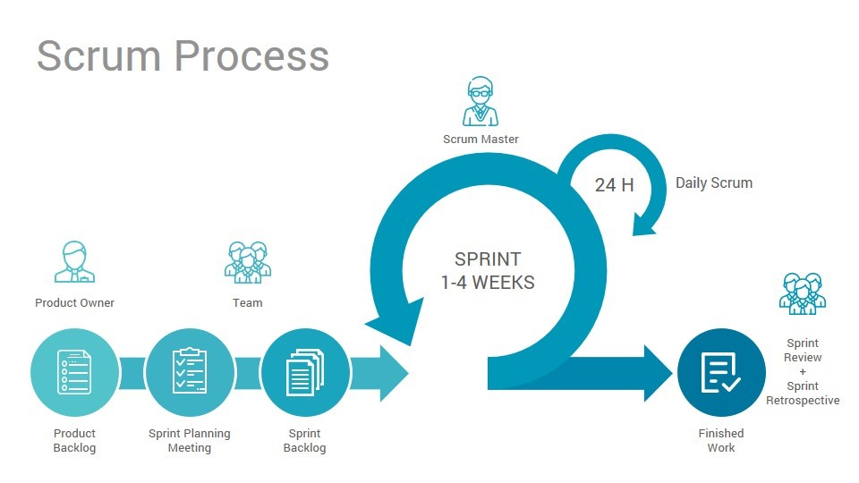
Scrum Overview
Scrum (n): An empirical framework within which people can address complex adaptive problems, while productively and creatively delivering products of the highest possible value
– Scrum.org
Scrum is:
Lightweight
Simple to understand
Difficult to master
Potentially Shippable Product Increment
Notes:
Scrum promotes a customer-centric approach by prioritizing the most valuable features and delivering them early and frequently. It provides a framework for continuous feedback, enabling teams to adapt to changing requirements and deliver high-quality software. Scrum's transparent approach ensures that stakeholders have visibility into the project's progress and impediments, fostering effective collaboration.

Slide 17
Scrum: 3-5-3
3
Roles
Product Owner
Team/Agile team
Scrum Master
5
Events
Sprint Planning
Sprint
Daily Scrum/Stand-up
Sprint Review/ Demo
Sprint Retrospective
Backlog Refinement
3
Artifacts
Product Backlog
Sprint Backlog
Potentially Shippable Product Increment
Backlog Refinement*
Potentially Shippable Product Increment

Slide 18

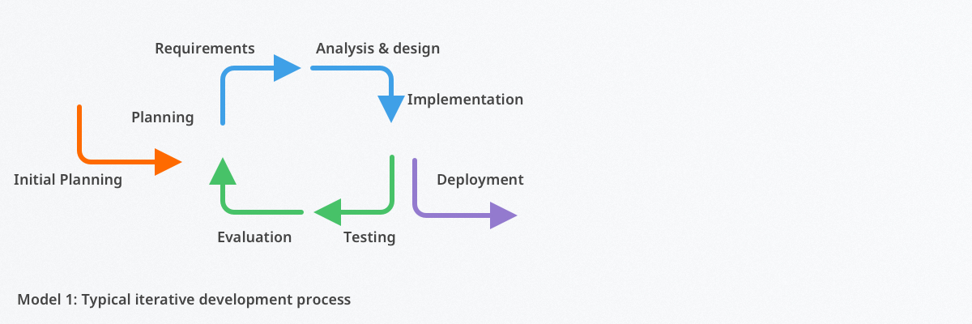
Iterative Process
Breaks down large tasks into smaller pieces that can be repeated, refined, and researched throughout the software development cycle.
Also called as PDCA model:
P (Plan) – Iteration planning focuses on the planning and discussion of requirements and objectives of an iteration/sprint.
D (Design) – Iteration implementation is concerned with the analysis, design, and implementation of projects. The team develops & tests software during this phase of the cycle.
C (Check) – Iteration testing is concerned with ensuring the deliverable meets project requirements. If certain criteria are not met, the team can move backward to the other phases for further improvements.
A (Adjust) – Iteration evaluation means comprehensively reviewing the work of the iteration or cycle. The software development team will also refine its backlog to prepare for future iterations.
Notes:
Also called as PDCA model:
P (Plan) – Iteration planning focuses on the planning and discussion of requirements and objectives of an iteration/sprint.
D (Design) – Iteration implementation is concerned with the analysis, design, and implementation of projects. The team develops & tests software during this phase of the cycle.
C (Check) – Iteration testing is concerned with ensuring the deliverable meets project requirements. If certain criteria are not met, the team can move backward to the other phases for further improvements.
A (Adjust) – Iteration evaluation means comprehensively reviewing the work of the iteration or cycle. The software development team will also refine its backlog to prepare for future iterations.

Slide 19
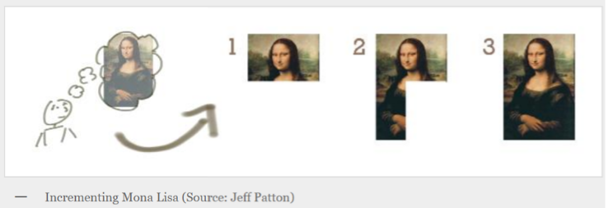
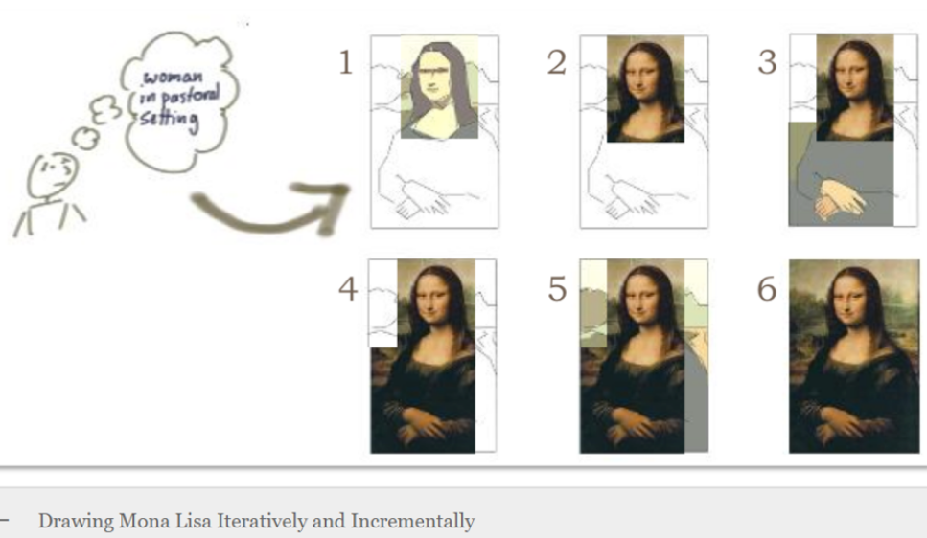
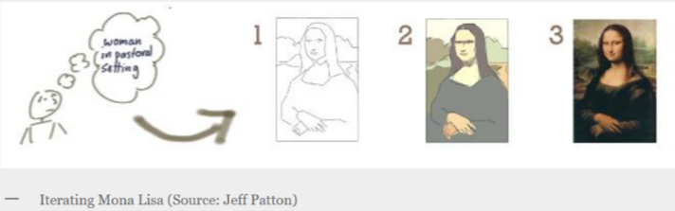
Iterative or Incremental

Slide 20




Thank you!
Notes:
Mandatory -- Need bookend -- first and last thing they should see is DevelopIntelligence
ACTION: Use this for the final slide of your class materials.

